Slide 1
Основните принципи на фотографията и кинематографията

Slide 2
Каква е разликата?
Notes:
The difference is at the prefixes. The suffix is known.

Slide 3
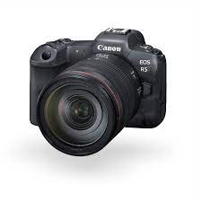


Notes:
What in a frame (footage) can move? What is a frame? Difference between frame and footage?

Slide 4
Фото-графия
Notes:
The difference is at the prefixes. The suffix is known.

Slide 5
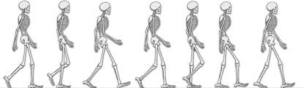
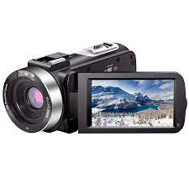
Notes:
What in a frame can move? What is a frame?

Slide 6
Кинемато-графия
Notes:
The difference is at the prefixes. The suffix is known.

Slide 7
Какво е най-важното при снимката/кадъра?
Notes:
What is the most important thing about a shot?

Slide 8
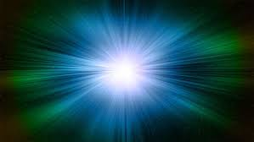
Light
Notes:
Left only the light and continue with describing of the other concepts. The most important is light. But what about the others?

Slide 9
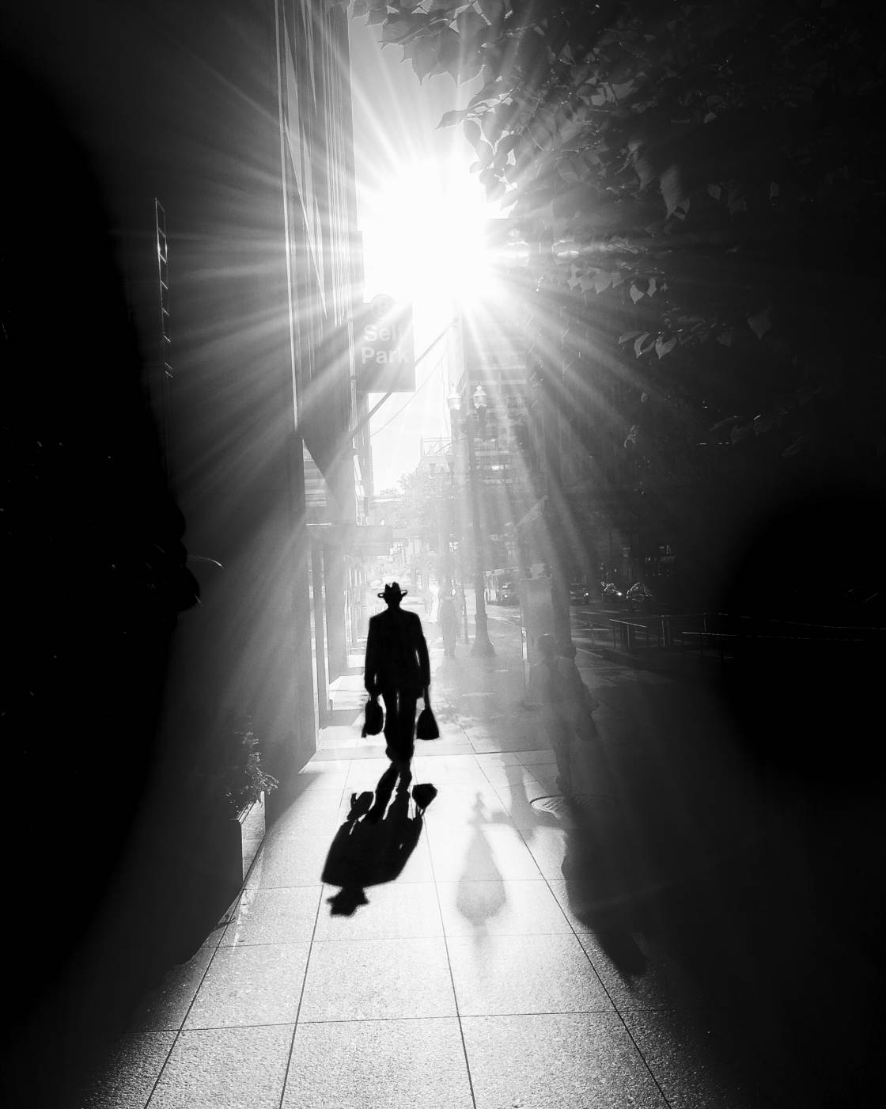
shadow
shadow
shadow
light
Notes:
The main structure of a photo is to not be smooth. That means to be filled with light, shadows and objects.

Slide 10
Черно-бял контраст

Slide 11
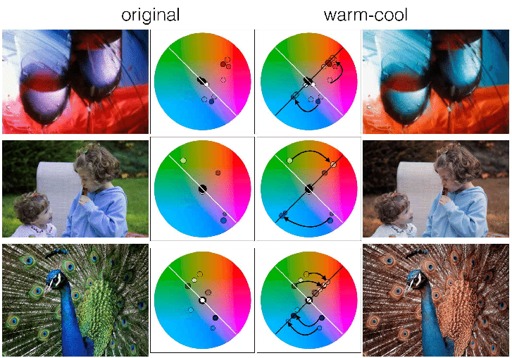
Оригинално
Топъл

Slide 12
Студен-Топъл Контраст

Slide 13
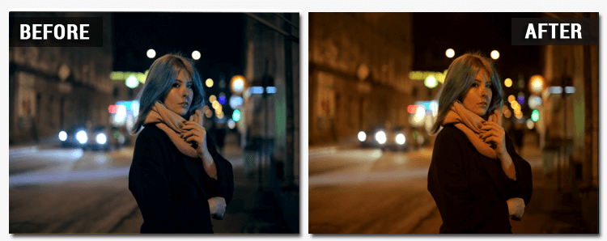

Slide 14
Цветен контраст

Slide 15
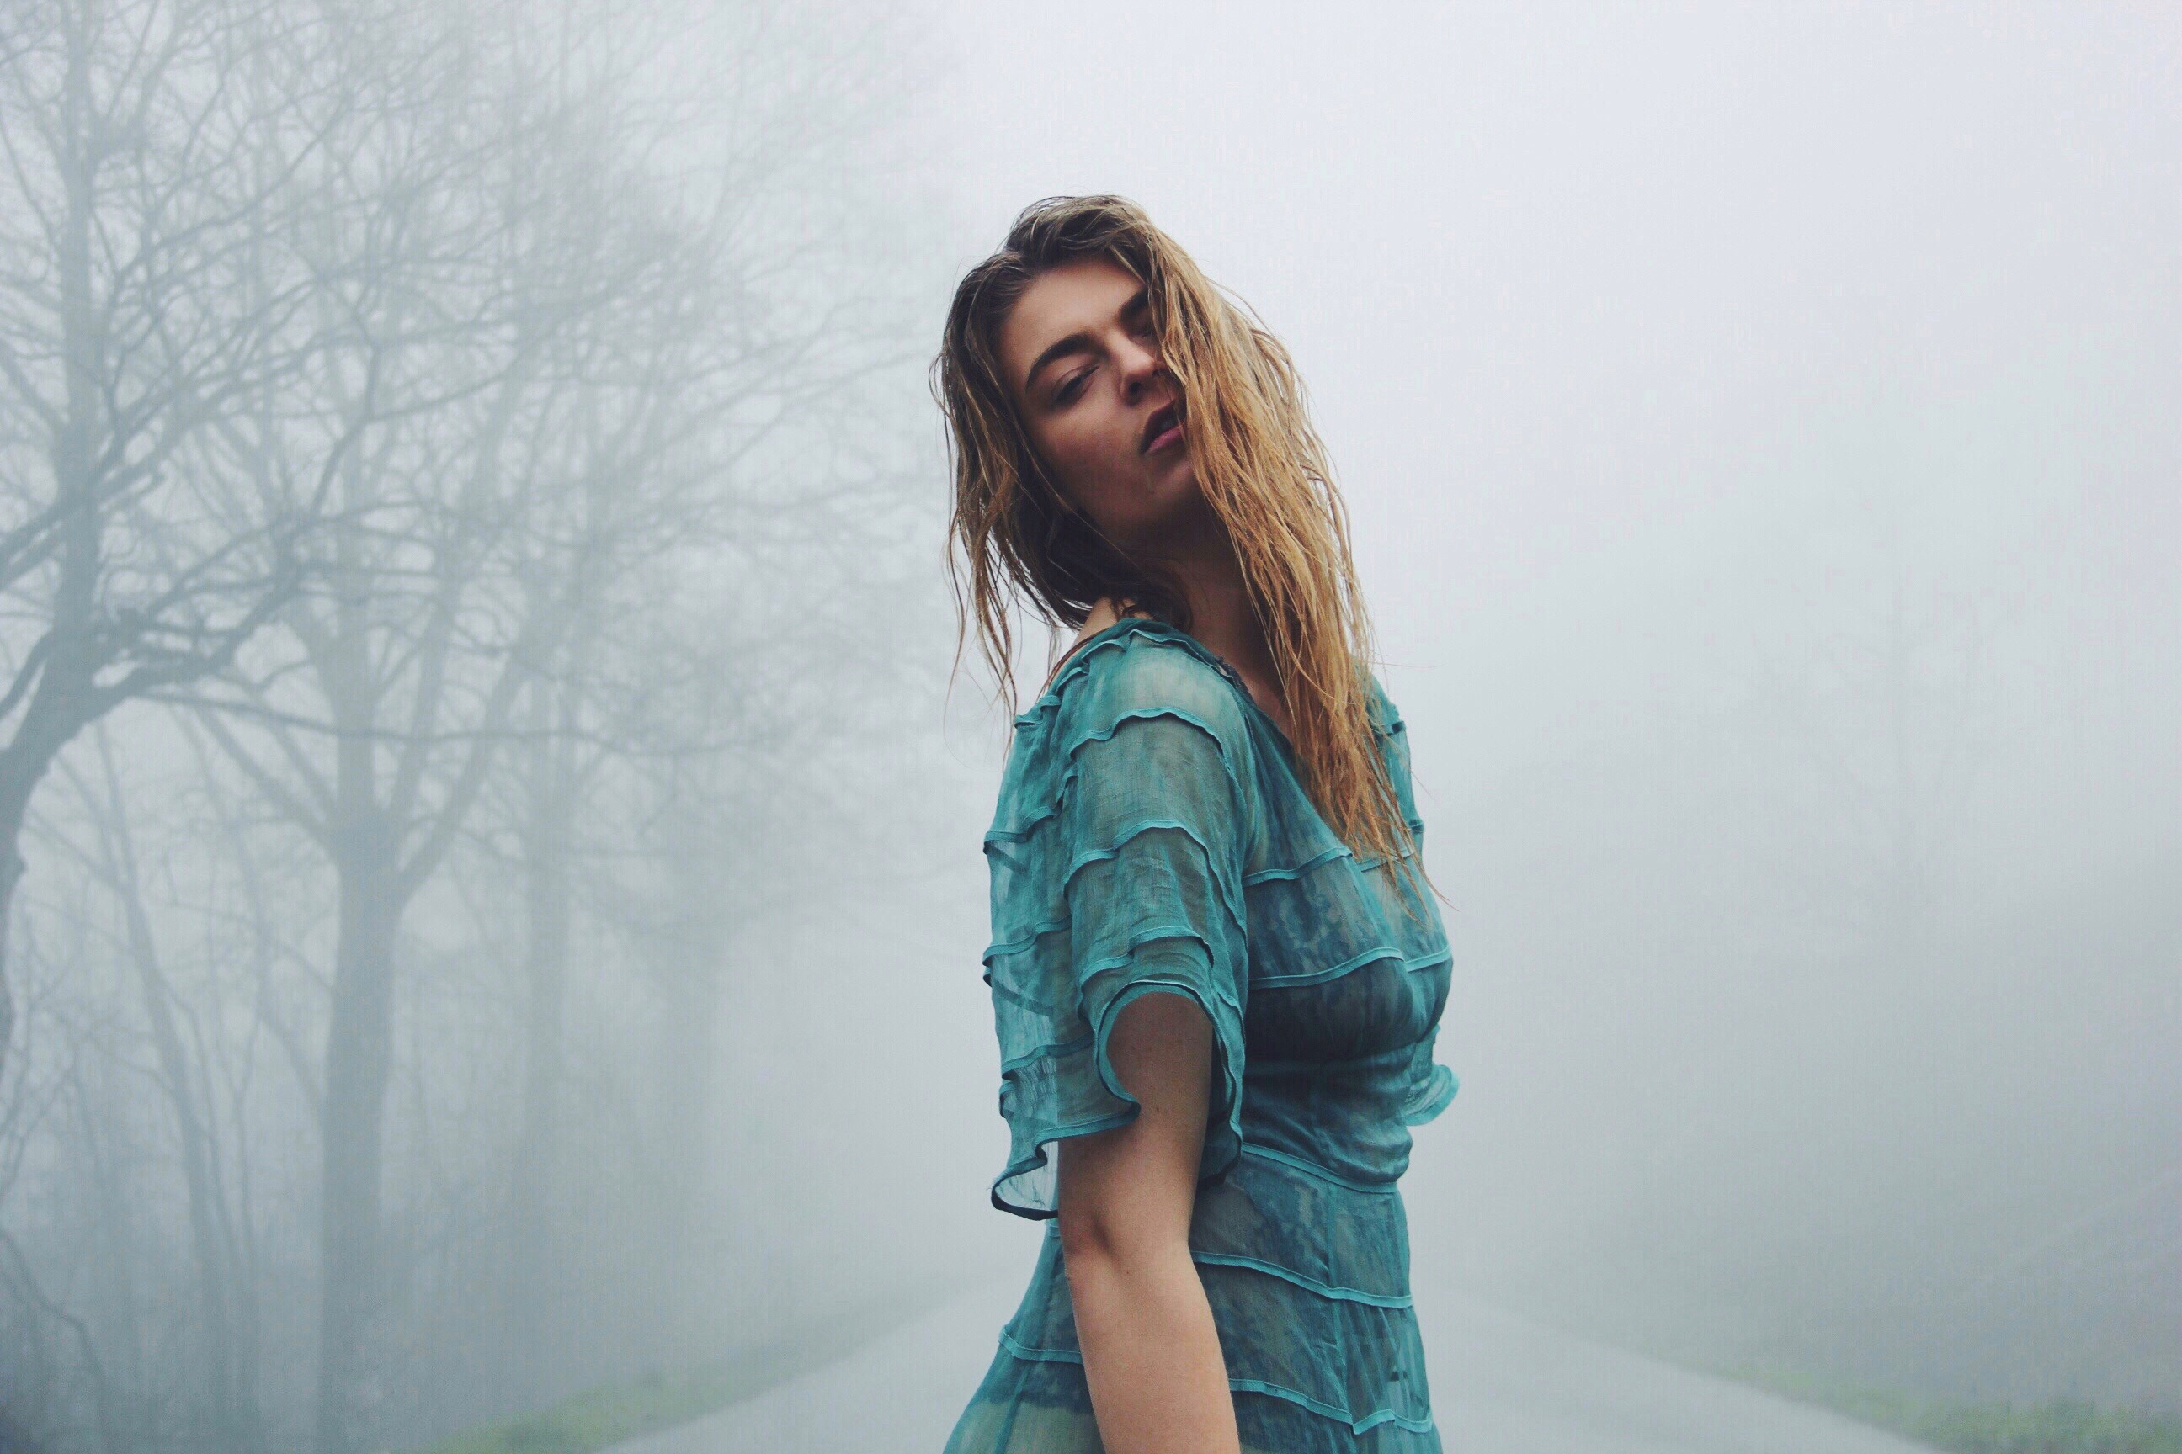

Slide 16
Контраст на плътност

Slide 17
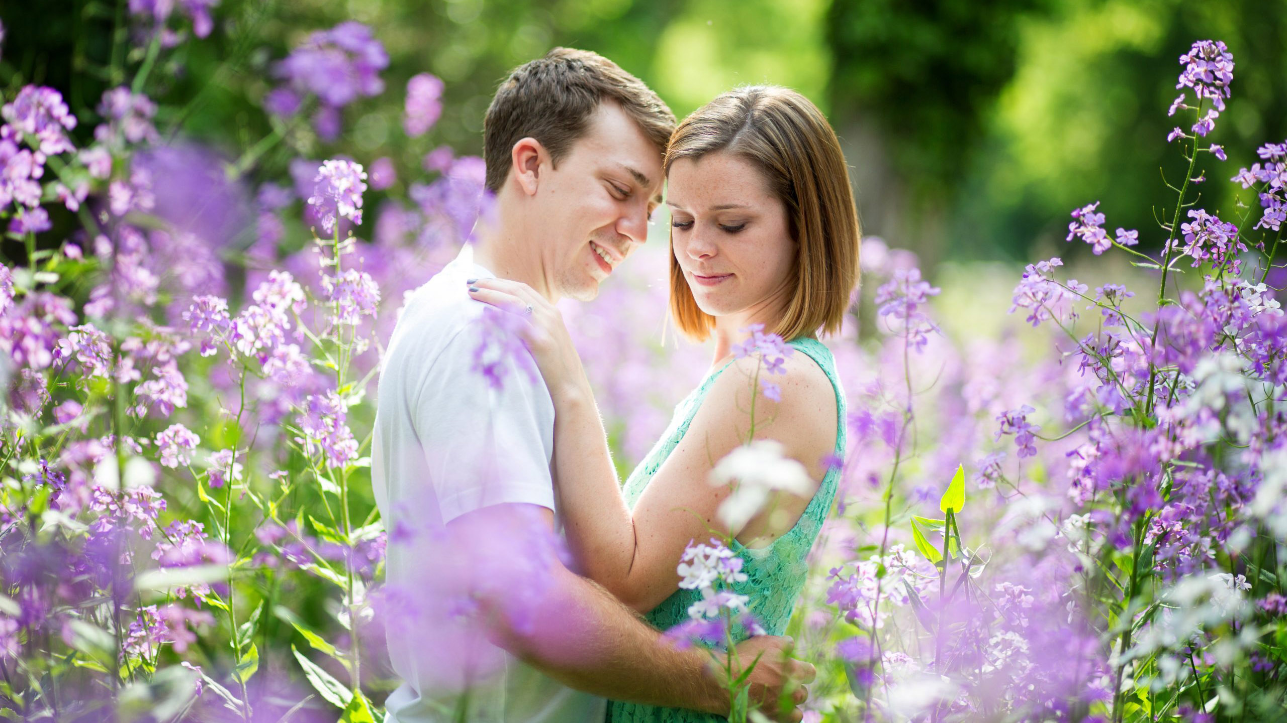

Slide 18
Оптичен контраст
Notes:
Or focus

Slide 19
Контрастът
Notes:
When I illuminate an object? I see the colors and contrasts help me to locate the space

Slide 20
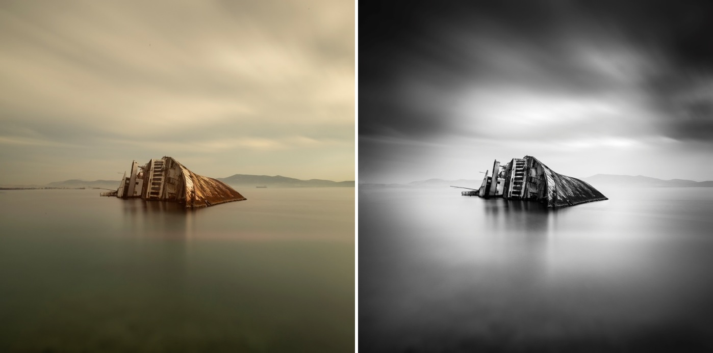
Notes:
What are the tonalities here? Where are the bright/dark/middle parts. What is a tonality?

Slide 21
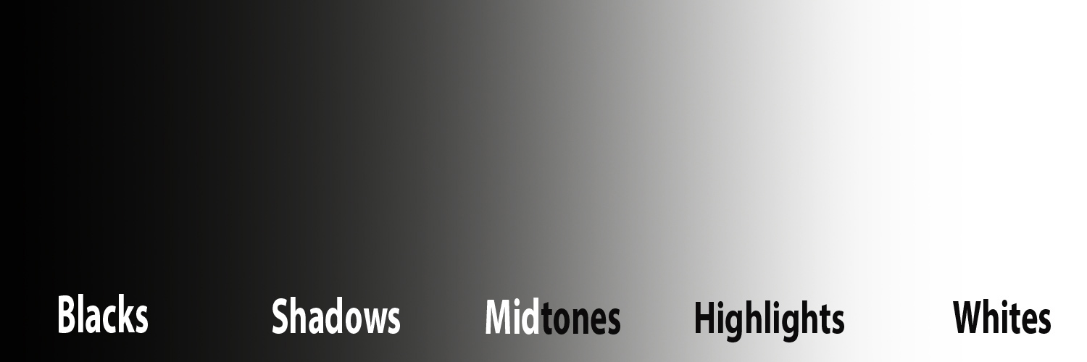
Notes:
tonality

Slide 22
Светлина
Контраст
Цвят
Notes:
Yes, and here there are the three consepts.

Slide 23
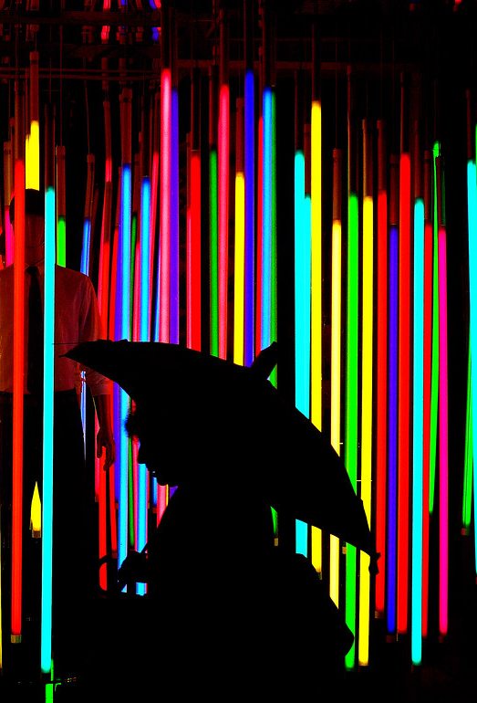
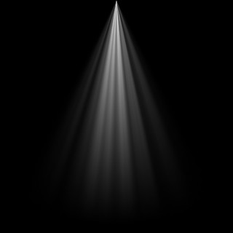


Slide 24
Как да приложим тези концепции?
Notes:
How to apply these concepts

Slide 25
Дизайн на сцената
Notes:
Set design – To apply the concepts we need space

Slide 26
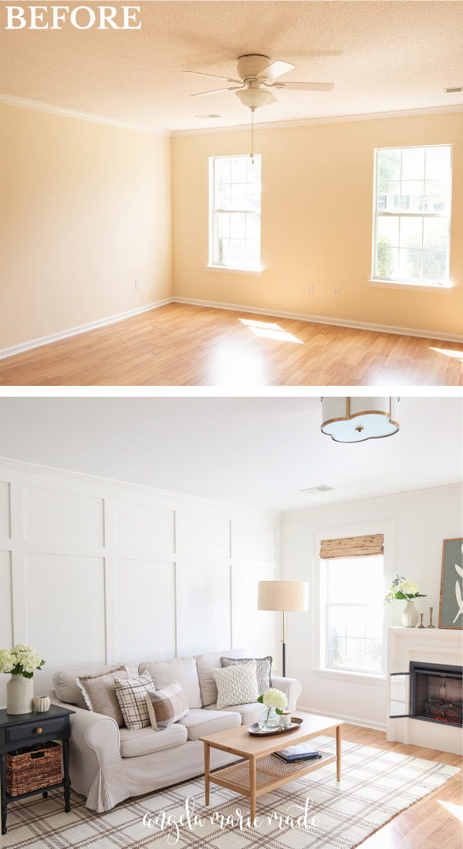
Notes:
These three concept plus set design(location of the requisite) done the frame spatial not flat

Slide 27
Notes:
Of course this requisites have to be arranged on particular place. To not be in a layer. The furniture have to be in more than a layer.

Slide 28
Видове цветови схеми
Notes:
What is the harmony in colors

Slide 29
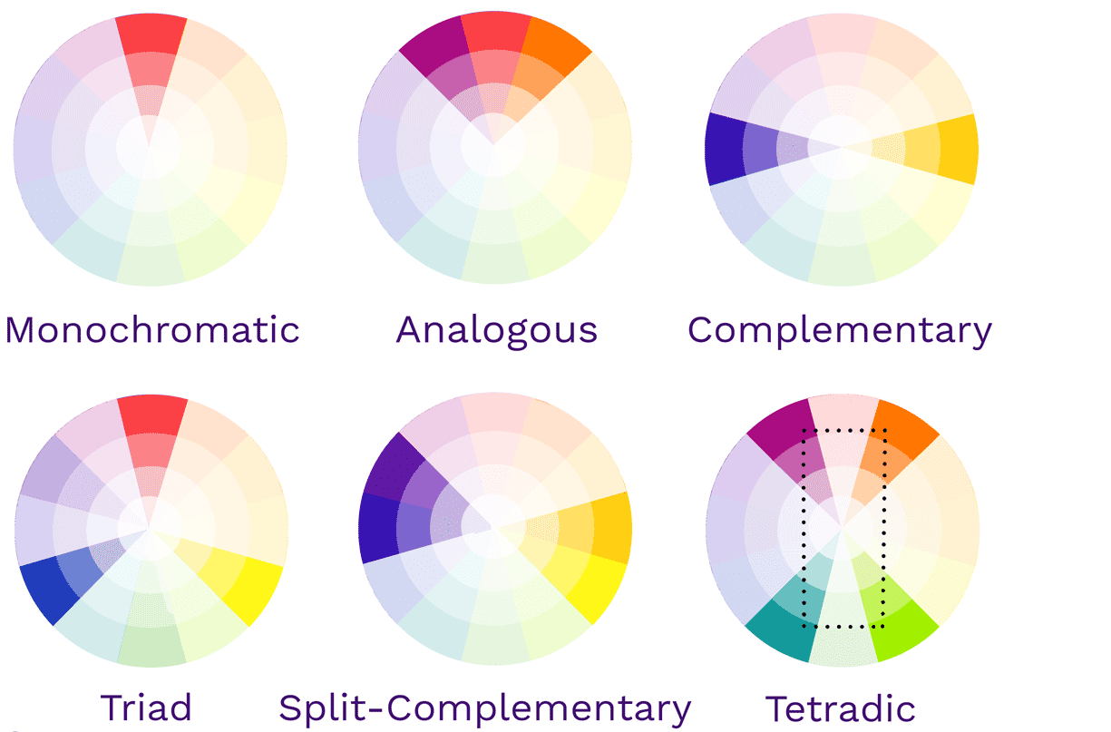
Notes:
We have to think first of all what is the outer colors and then what will be our colors (of our cloats)

Slide 30
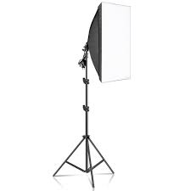
Ние имаме
Notes:
How to apply these concepts

Slide 31
Четирите начина за осветяване на обект
Notes:
How to apply these concepts

Slide 32
Запълваща светлина
Notes:
How to apply these concepts

Slide 33
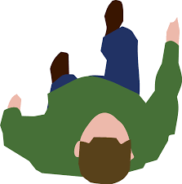
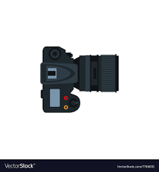
Notes:
So called document photography – the most used way of shooting

Slide 34
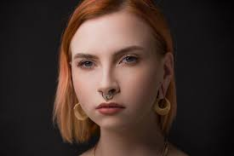

Slide 35
Рисуваща свелина
Notes:
How to apply these concepts

Slide 37
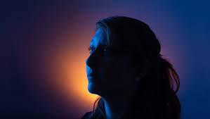

Slide 38
Контражур
Notes:
How to apply these concepts

Slide 40
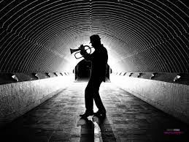

Slide 41
Силует
Notes:
How to apply these concepts

Slide 43
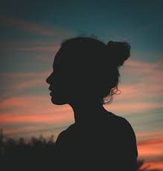

Slide 44
Доброволци?

